Slide 2
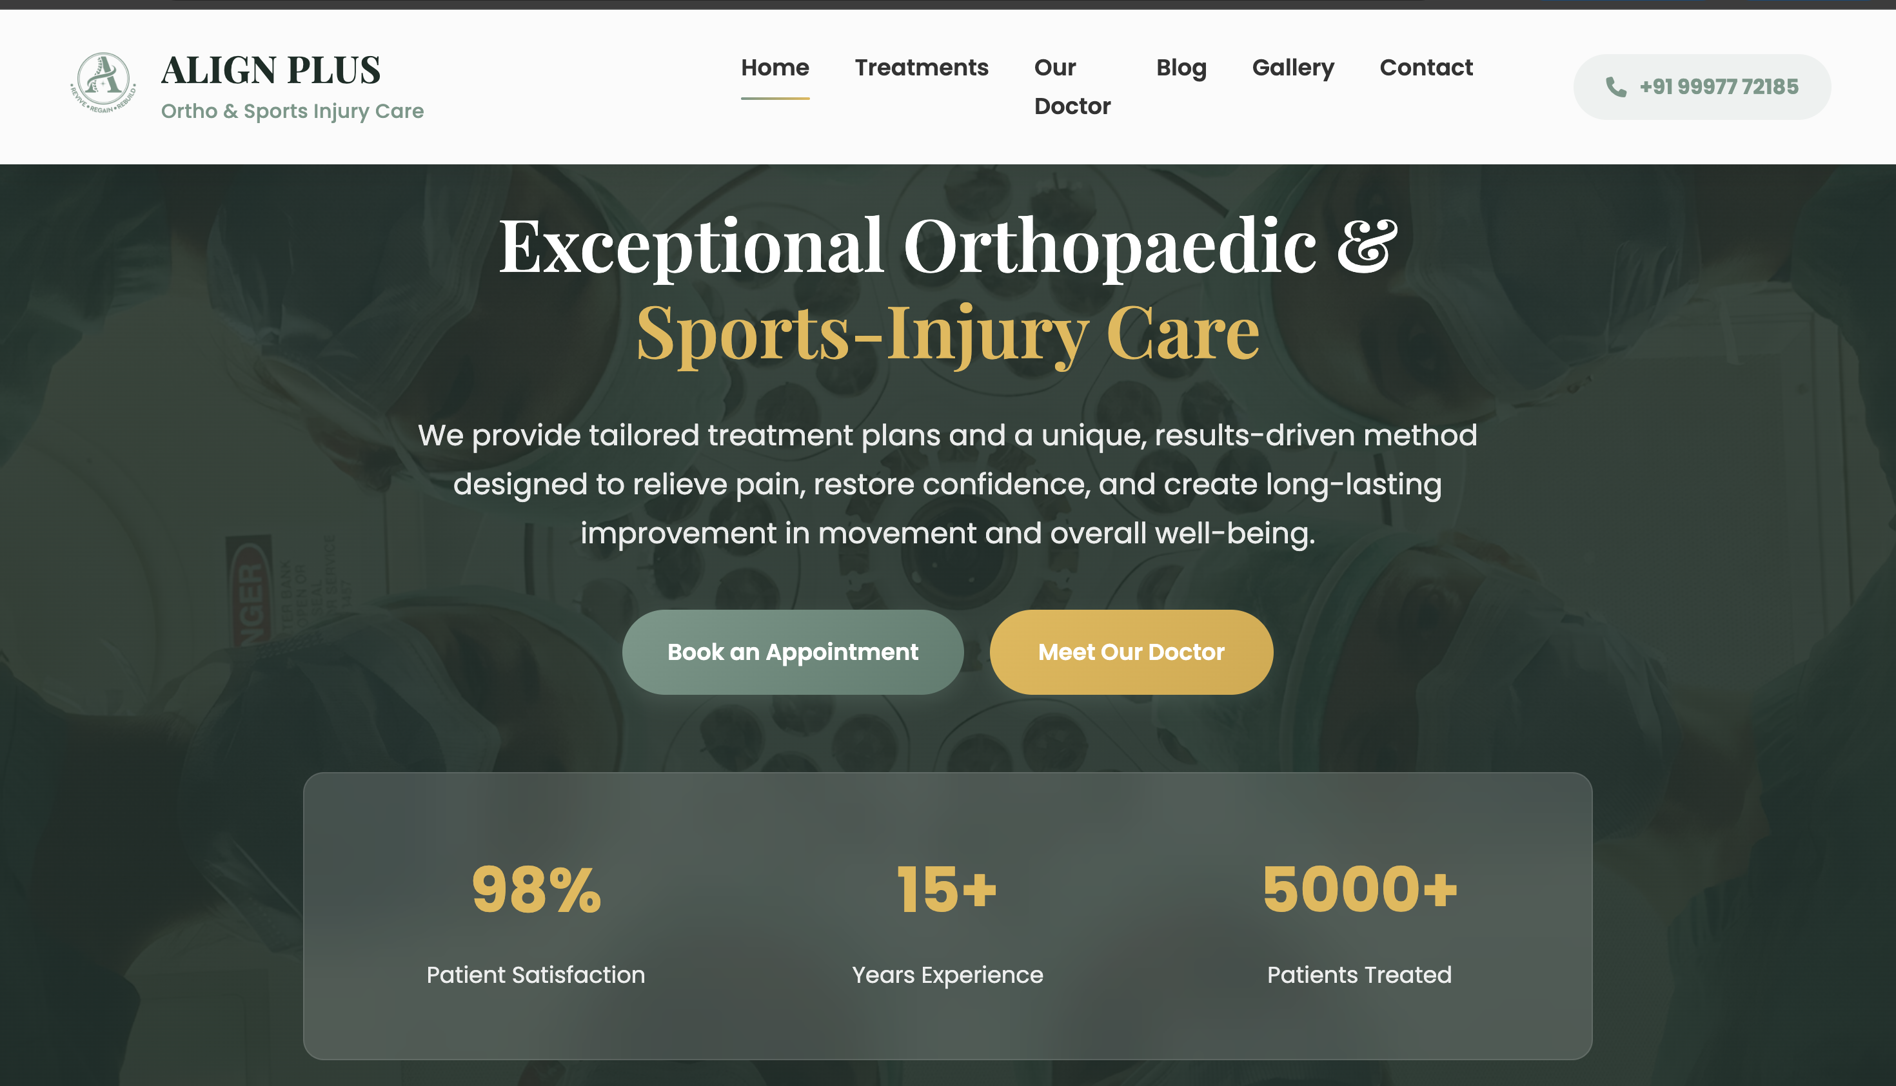
Background Align plus logo

Slide 3
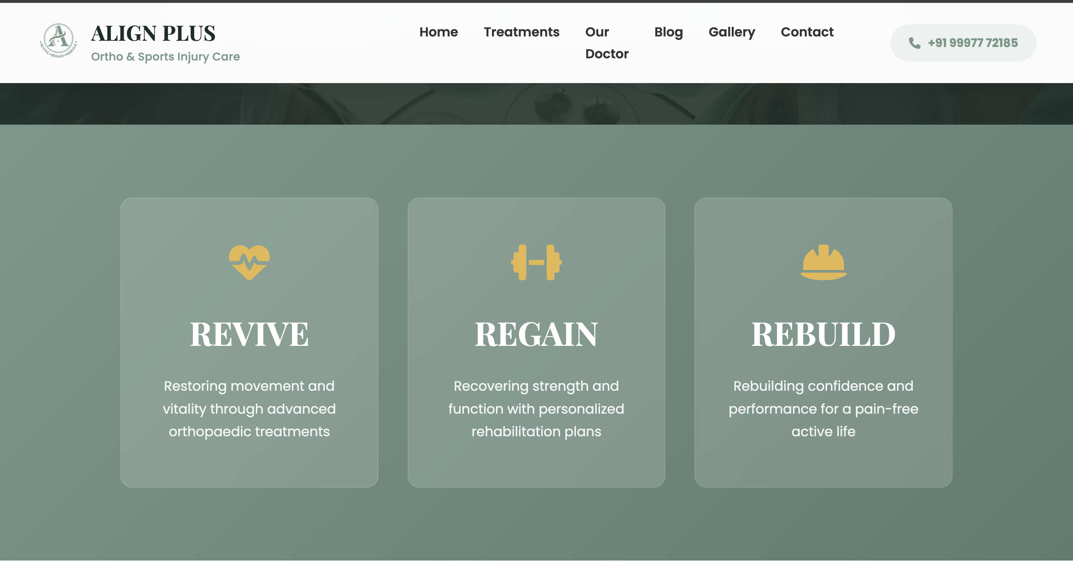

Slide 4
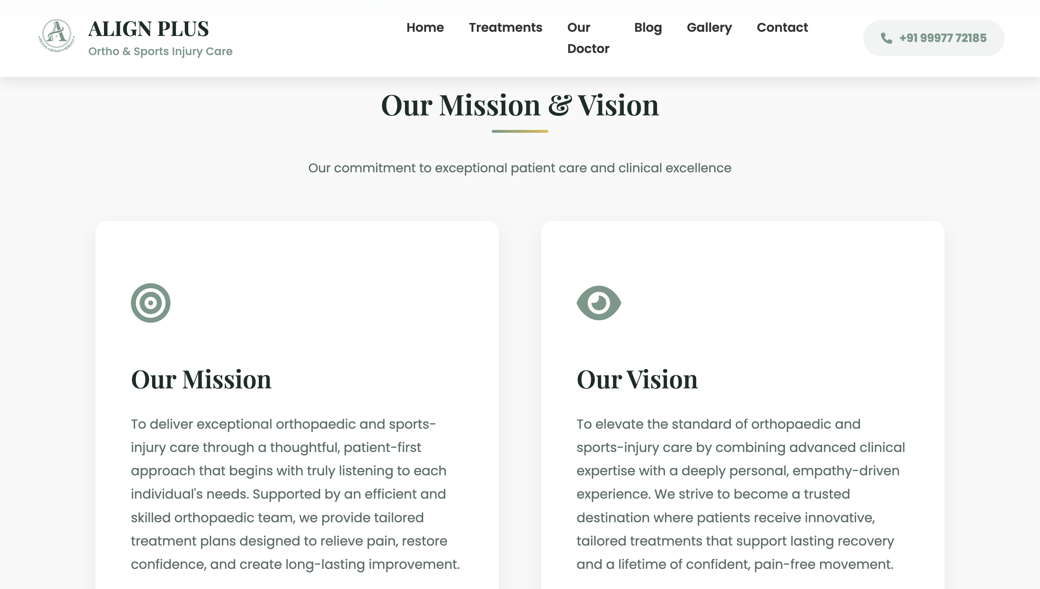

Slide 5
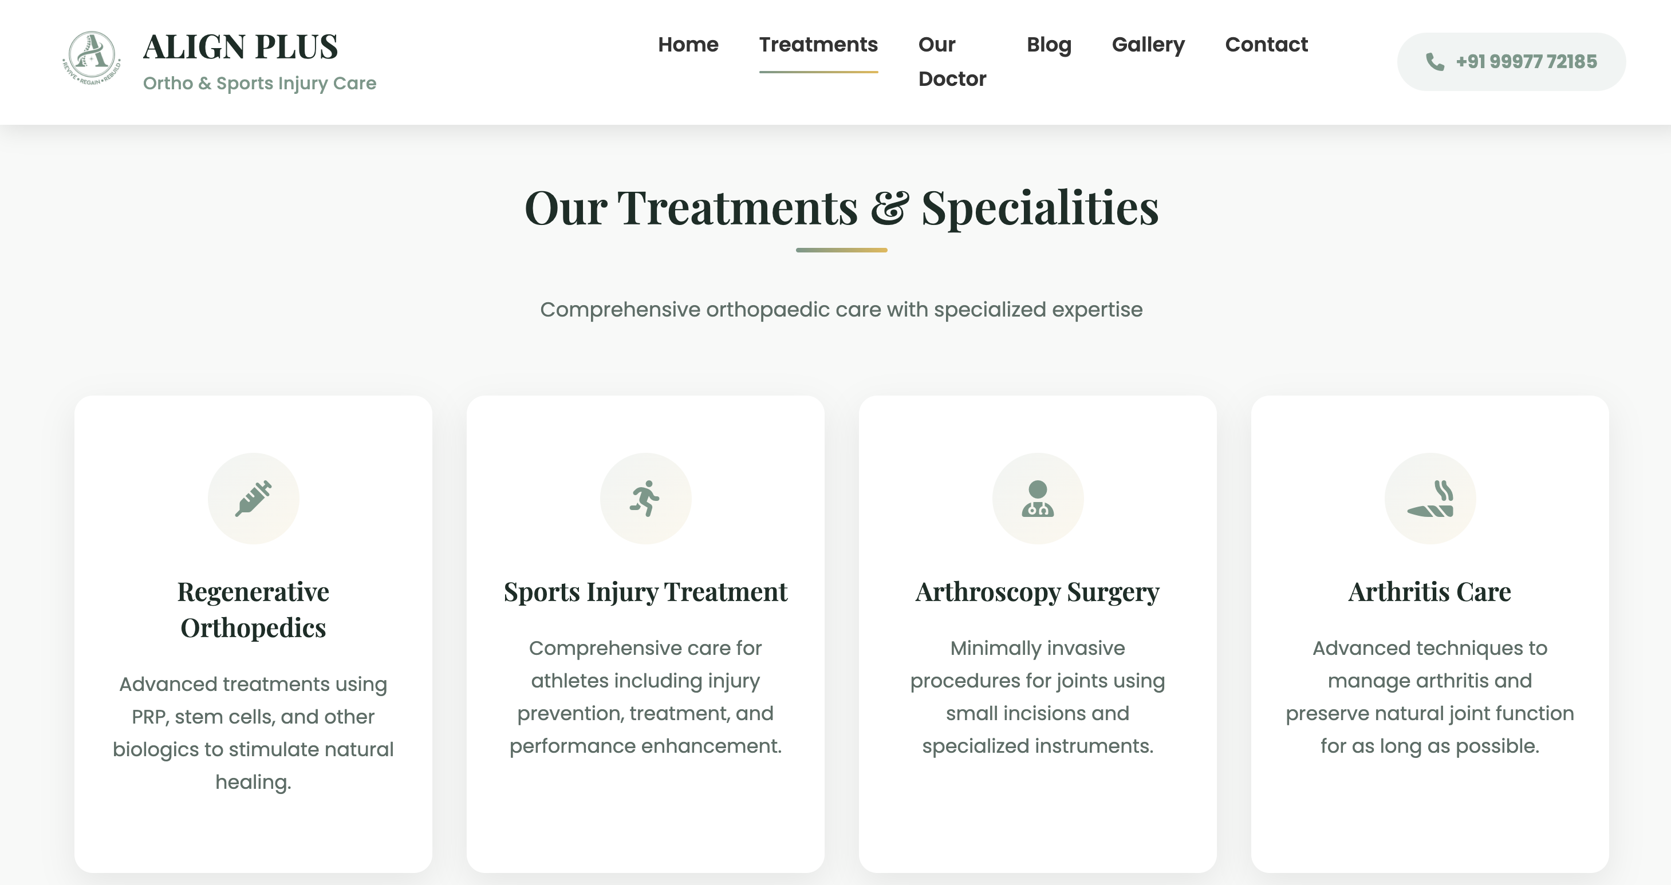

Slide 6
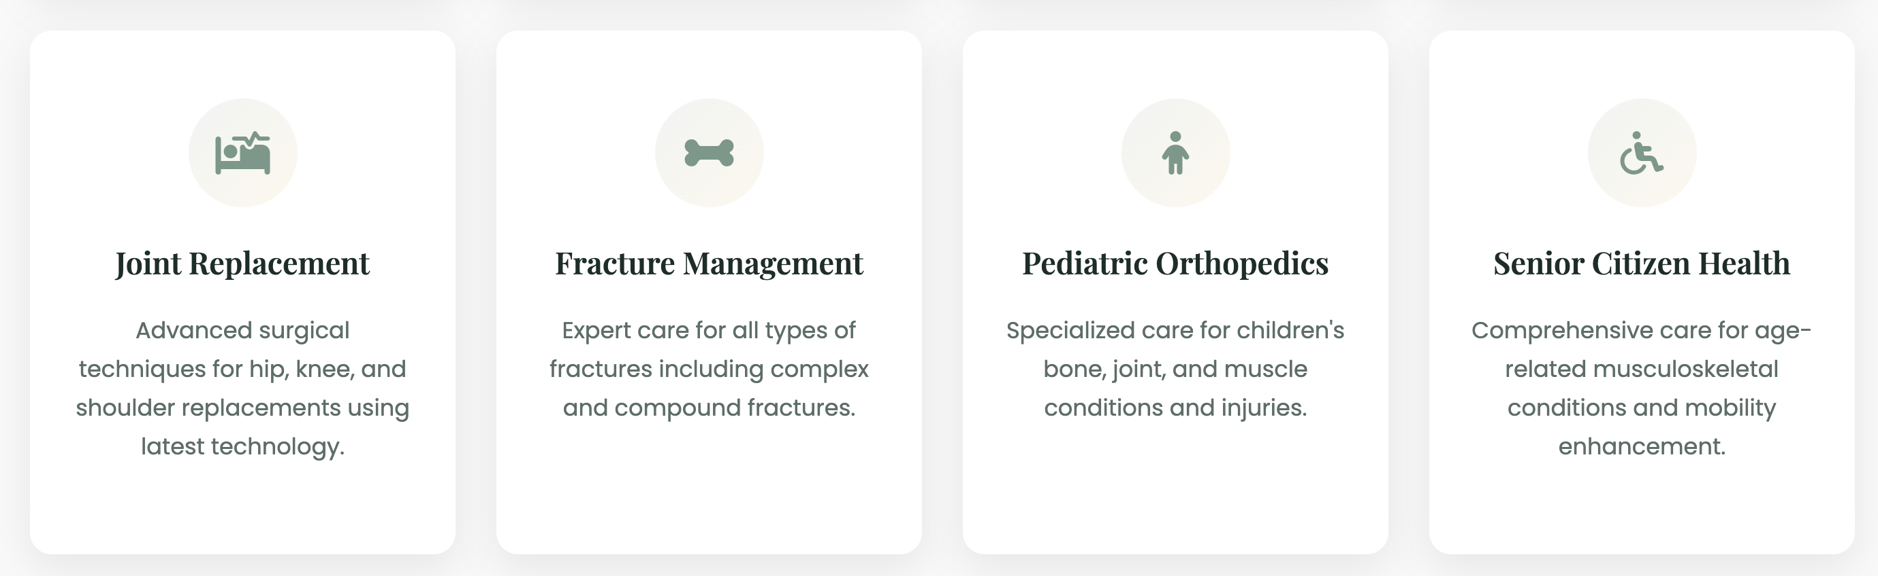

Slide 7
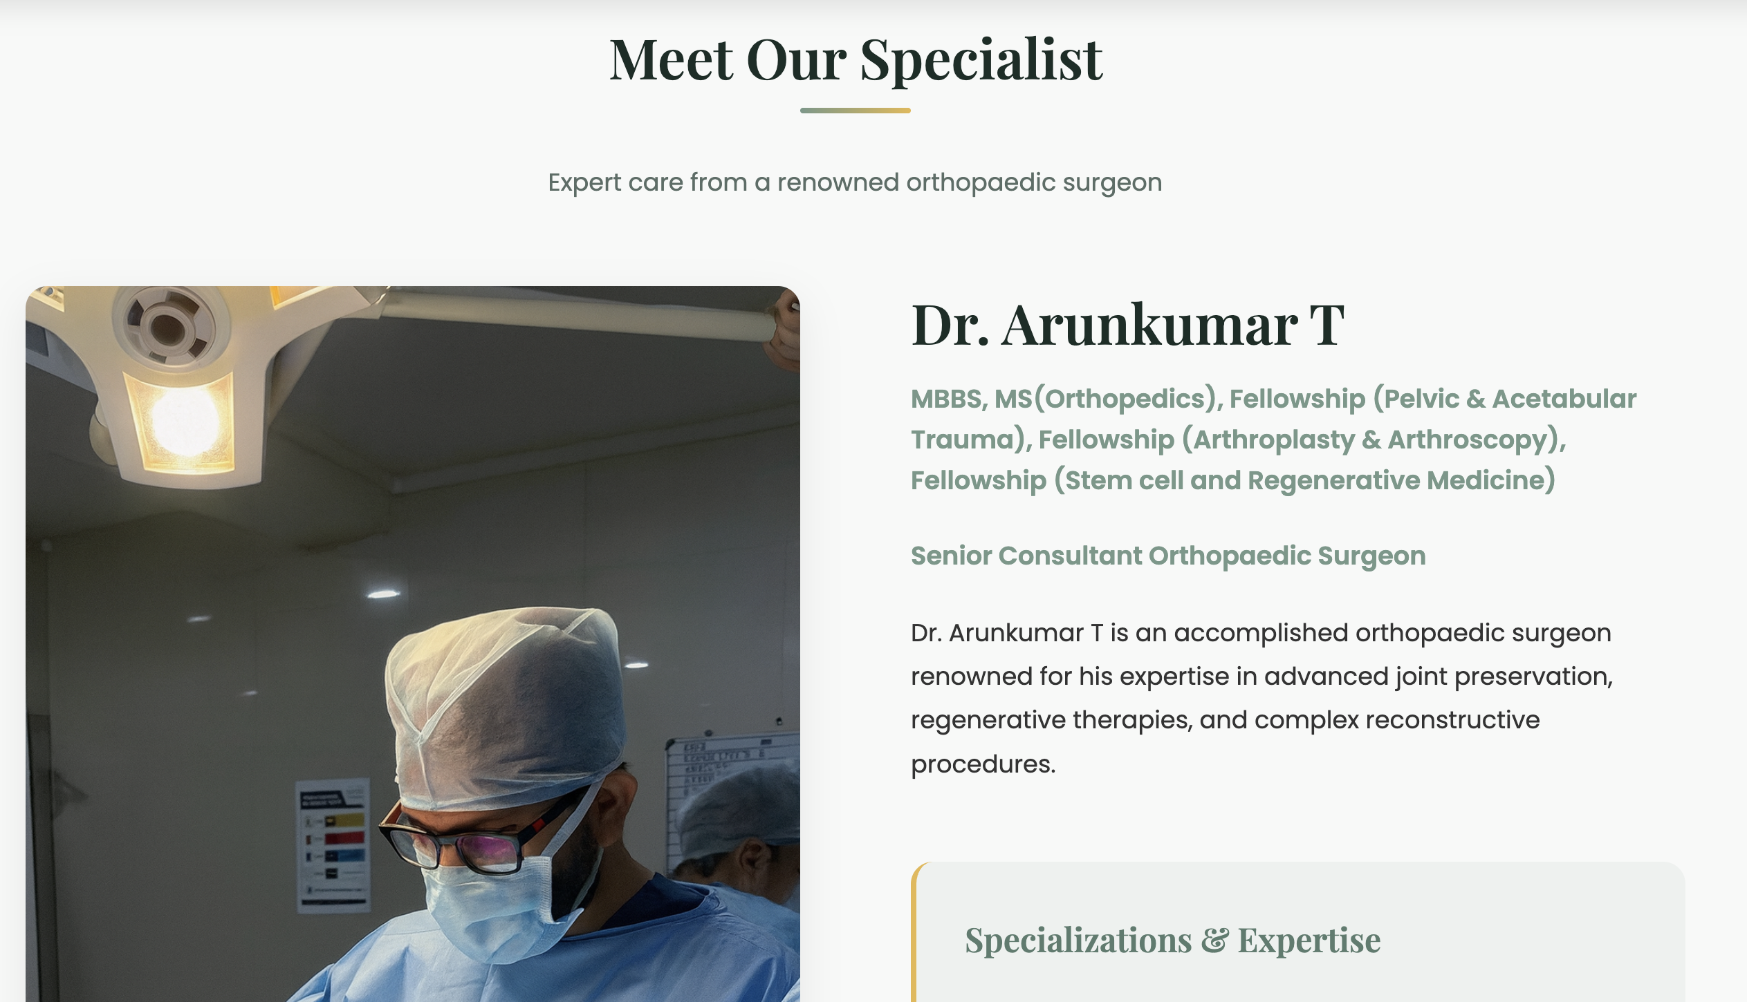
MBBS, MS(Orthopedics)
Fellowship ( Pelvic & Acetabular Trauma )
Fellowship ( Arthroplasty & Arthroscopy )
Fellowship ( Stem cell and Regenerative Medicine )

Slide 8
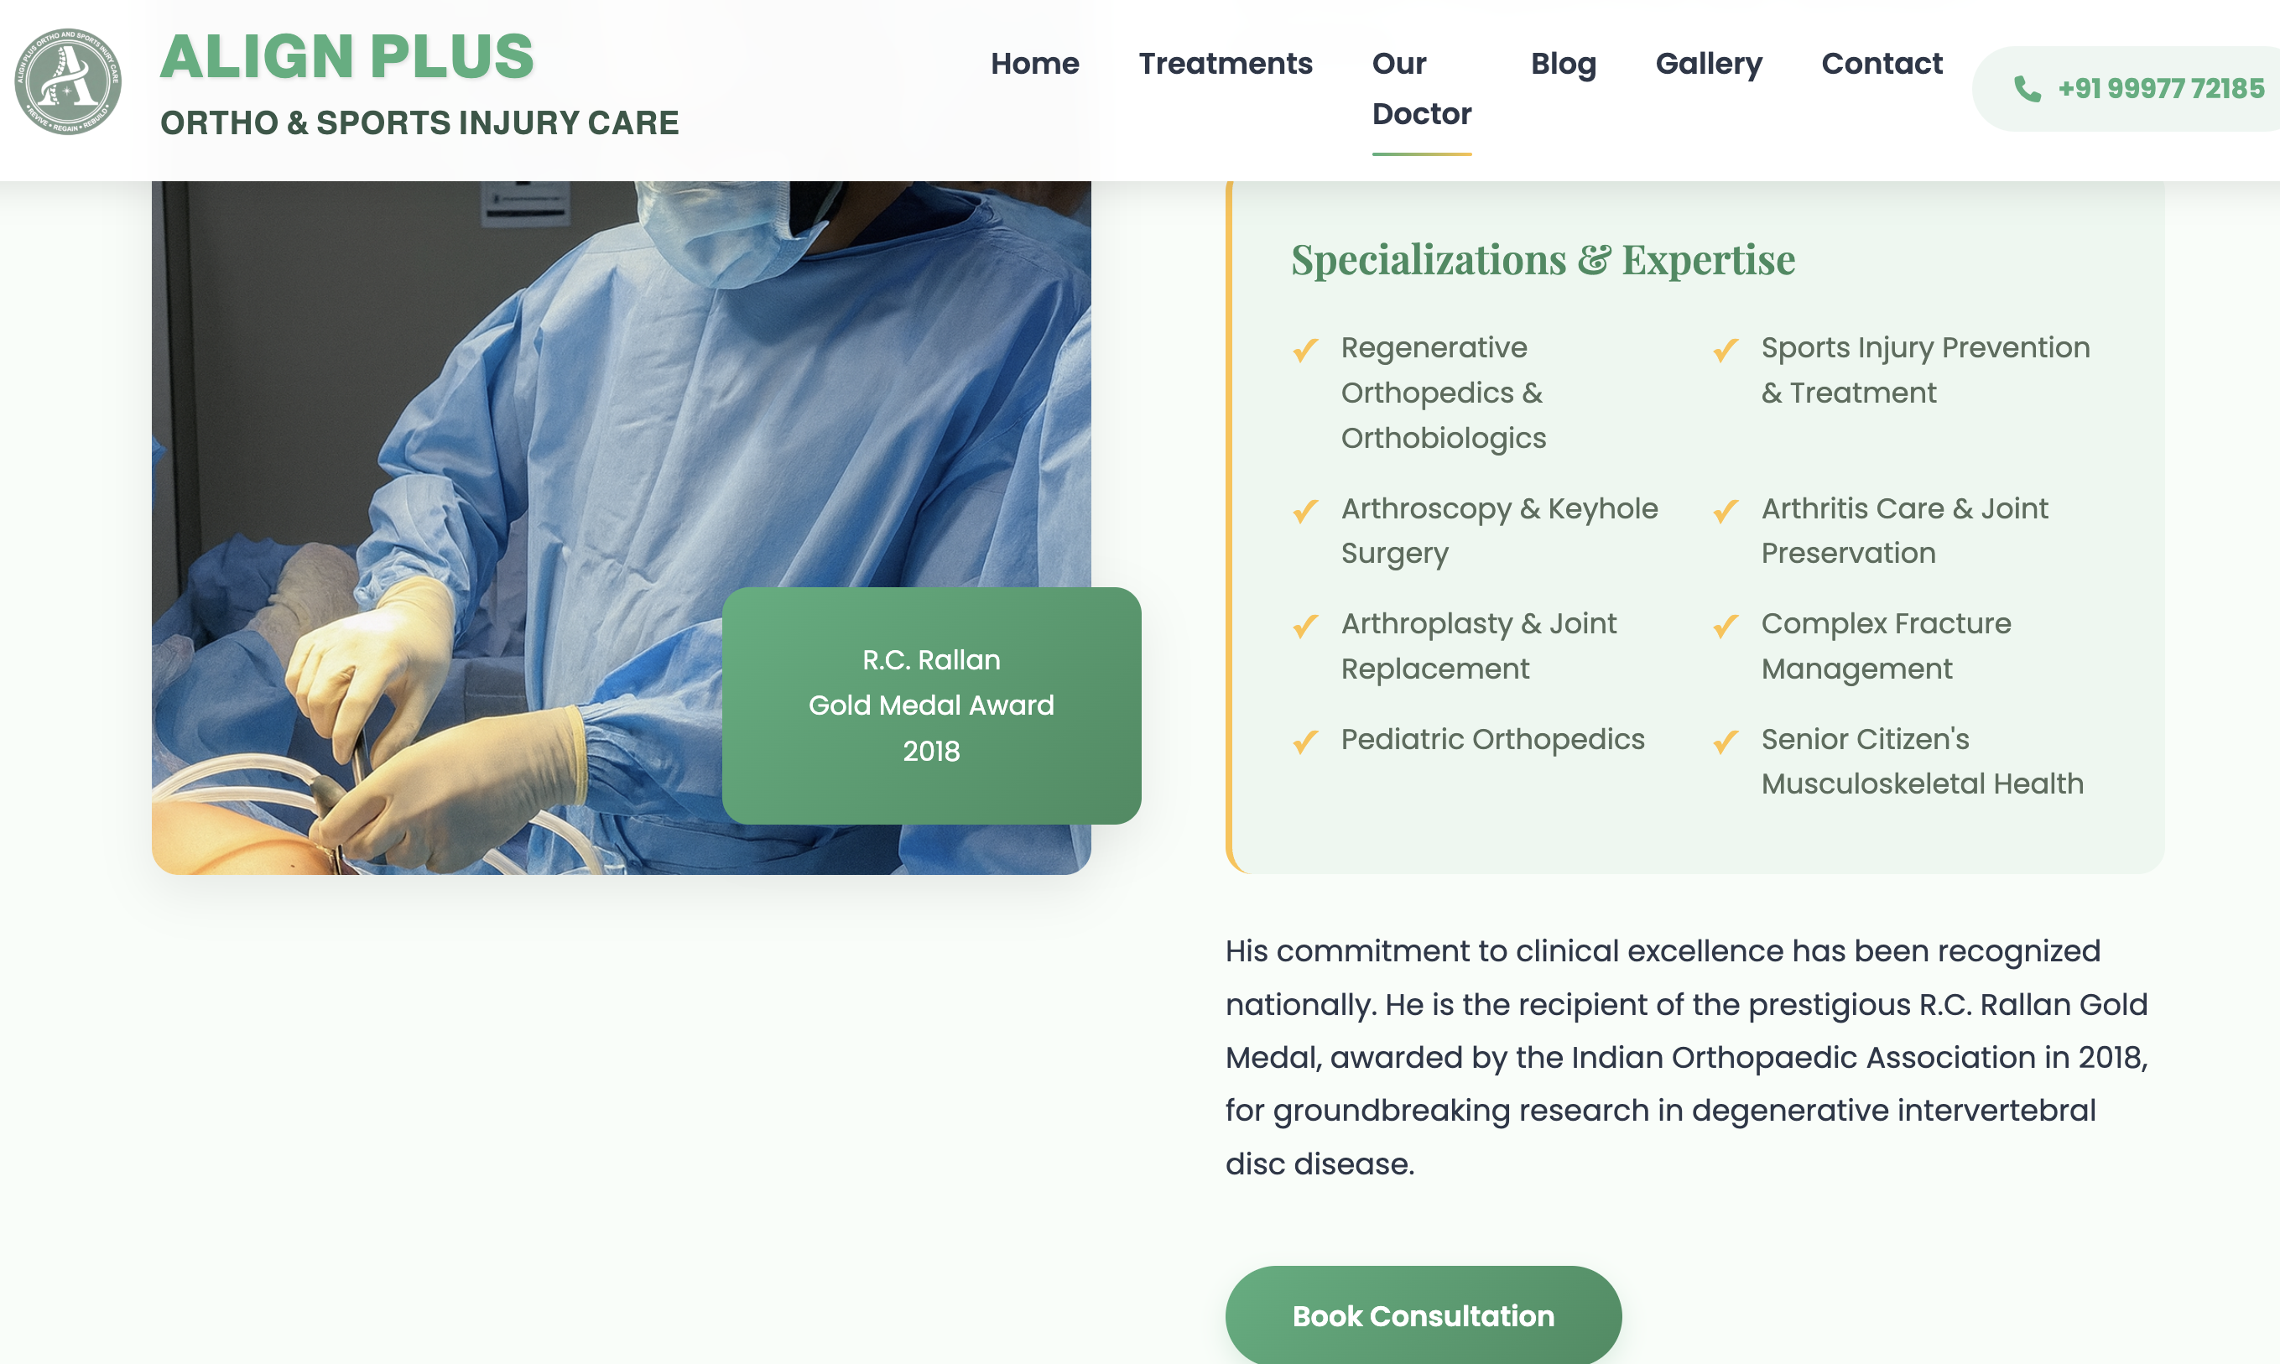
Regenerative Orthopedics
Arthritis Care & Joint Preservation
Sports Injury Prevention & Treatment
Arthroscopy
Arthroplasty
Complex fracture management
Pediatrics Orthopedics
Senior citizen’s Musculoskeletal Health

Slide 9
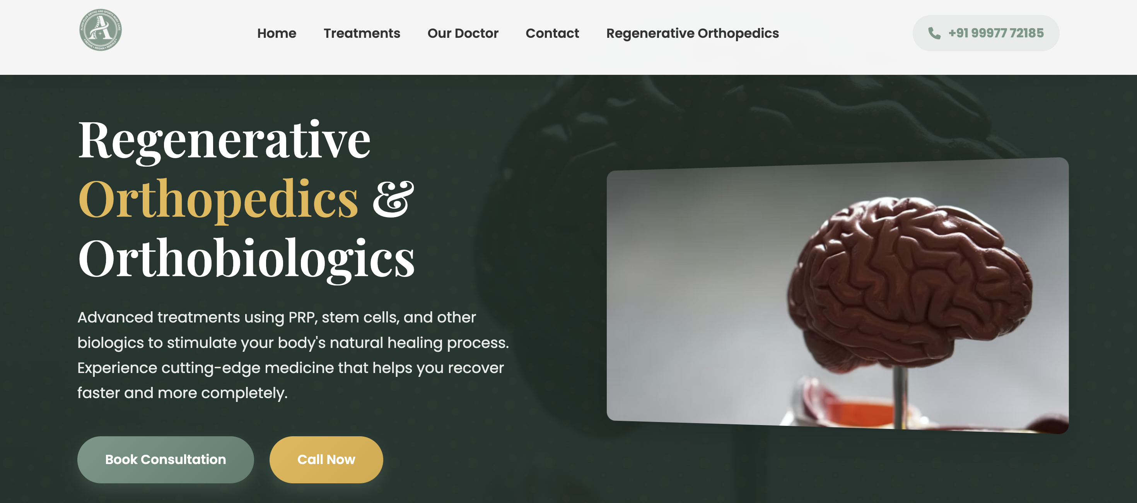
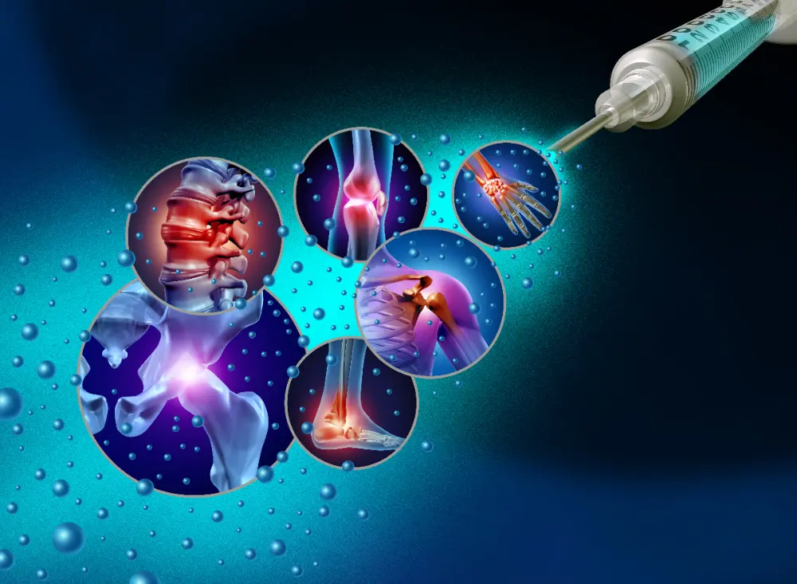
PRP, Stem cells ( BMAC – Bone Marrow Aspirate Concentrate, SVF Fat )
and other

Slide 10
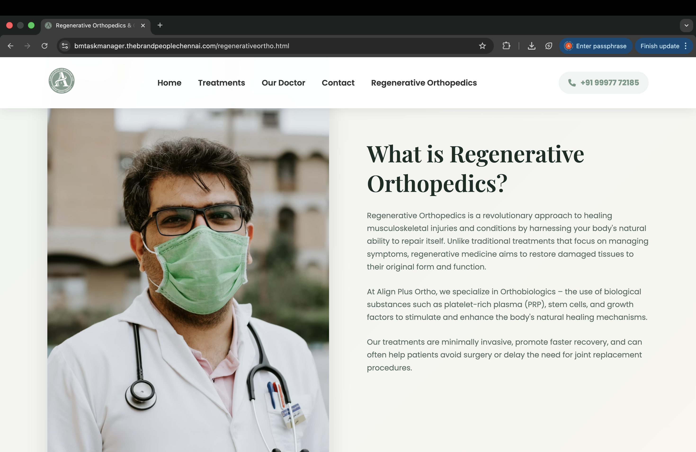

Slide 11
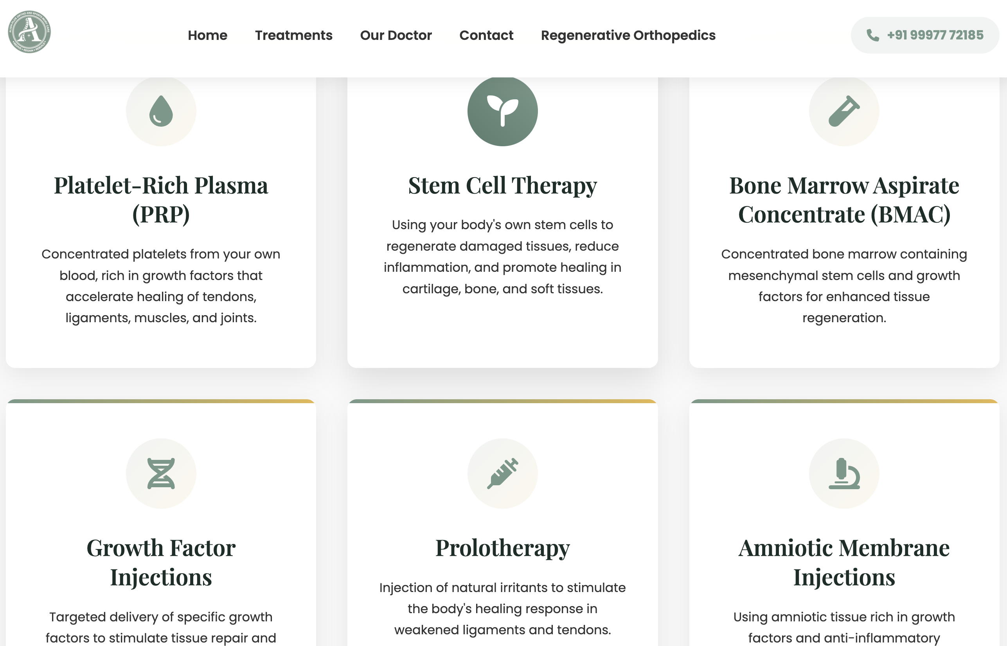
PRP & Growth factor are same
Remove prolotherapy & Amniotic membrane
injections

